Slide 1

NeMa: Fast Graph Search with Label Similarity
Arijit Khan, Yinghui Wu, Xifeng Yan
University of California, Santa Barbara
{arijitkhan, yinghui, xyan}@cs.ucsb.edu
Charu Aggarwal
IBM T. J. Watson Research Center
charu@us.ibm.com

Slide 2

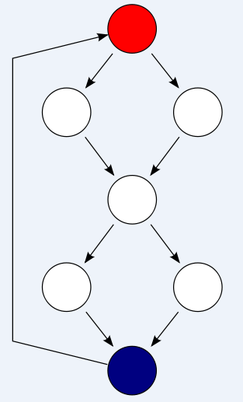
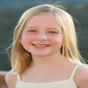

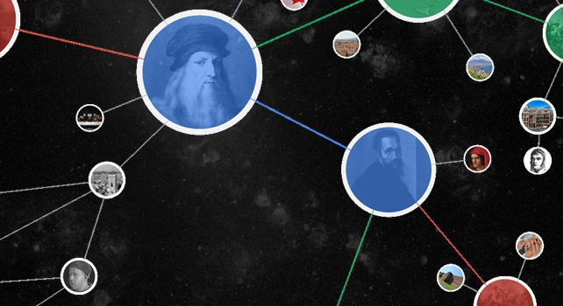
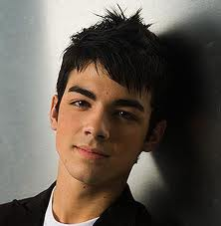


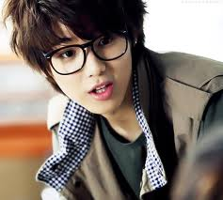
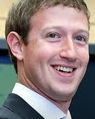


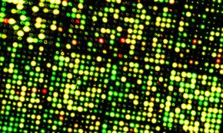
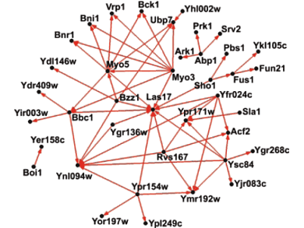
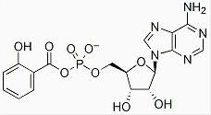
Data as Big Graphs
Knowledge Graph
Program Flow/ Callgraphs
Social Network
Image Data
Chemical Structure
Biological Network
1

Slide 3
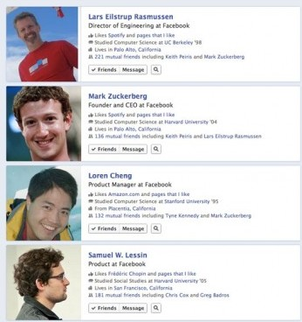

Web Search: Answers, not Links
“Search is about Answers, not just Links” – Sashi Seth, Senior VP of Yahoo! Search
Answering Web Questions Using Structured Data – Dream or Reality? - VLDB’09 Panel Discussion
Google Knowledge Graph
(May, 2012)
“People who like things I like” – an example of
Facebook graph search query (January, 2013)
2

Slide 4
Subgraph Search: Application in Malware Detection
Function 1
Exception
Function 8
Char [], double
Char[], double
Function 10
Function 11
Long, float
Function 9
Function 2
Exception
Function 5
Malware Pattern
Function 3
Function 7
Function 4
Function 6
- Is there a Malware embedded in the software?
Security and Intrusion Detection
Cesare et. al., TrustCom ’11
Fredrikson et. al., IEEE Symposium
on Security and Privacy ‘10
An Example CallGraph
3

Slide 5
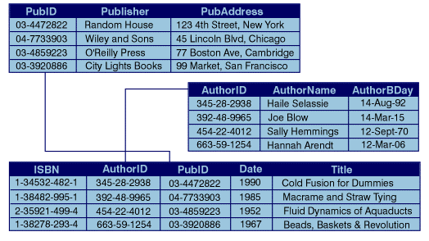
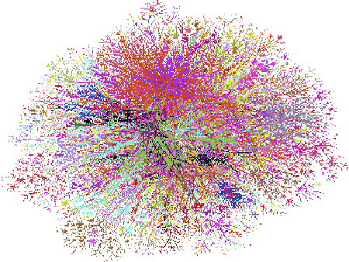
Why is Graph Search Difficult?
Heterogeneity → lack of standardized schema, or quite large schema (65K for DBpedia Data).
Uncertainty and noise.
Dynamic updates.
Massive volume.
Relational Data (Structured)
vs.
Fast query response time.
Heterogeneous Graph Data
(Semi-structured)
4

Slide 6
Graph Query
Query: Find a project that employee “Bob” is working on, and that project is supervised by the same Team_Leader who also works with employee “Alice”.
(Department)
Bob
work_in
?
Rob
DP0
(Project)
(Employee)
work_in
(Team
Leader)
?
supervise
work_in
(Employee)
(Team Leader)
Bob
(Employee)
Alice
work_on
Query Graph 1
supervise
PM02
PM01
John
(Employee)
Bob
(Project)
work_on
(Team Leader)
(Project)
Alice
Y.
(Project)
(Employee)
?
work_on
(Team
Leader)
work_in
?
(Employee)
work_in
?
Alice
M.
DP1
(Project)
Alice
(Employee)
(Department)
Query Graph 2
Knowledge Graph
5

Slide 7
Approximate Subgraph Search for Graph Querying
If two entities are close in the query graph, they should also be close in the data graph.
Subgraph Isomorphism
Subgraph Similarity Metrics
Graph Edit Distance, Maximum Common Subgraph, # of Missing Edges.
NP-hard → time consuming.
too strict to find approximate matches.
Not suitable to preserve closeness among entities.
u₁
preserve h-hop neighborhood information of each query node.
u₂
u₃
2-hop neighborhood
of u₁
u₄
u₅
6

Slide 8

Graph to Vector Conversion
Convert the h-hop neighborhood of each node u in G into a multi-dimensional vector R_{G}(u)={⟨u′, w_{u}(u′)⟩}, based on the distance of neighbor nodes u′ from u.
u₁
u₂
u₃
Distance between u and u’
u₄
h = 2, α = 0.5
R_{G}(u₁) = { ⟨u₂, 0.5⟩, ⟨u₃, 0.5⟩, ⟨u₄,0.25⟩ }
u₅
Information Propagation
Previous Applications of Information Propagation: Semi-supervised Learning [AI’ 08], Concept Propagation [CIKM ’06]
7

Slide 9
Subgraph Matching Cost Formulation
u₁
Φ
v₁
f(v₁,u₁)
u₂
u₃
Φ
v₂
f(v₂,u₃)
u₄
v₄
Φ
f(v₄,u₄)
u₅
Data Graph (G)
Query Graph (Q)
Subgraph Matching Cost Model
8

Slide 10

Individual Node Matching Cost
Individual Node Matching Cost:
Label Matching Cost + Difference between the neighborhood vectors
Label
Matching
Cost
Neighborhood
Matching
Cost
L₁ Difference Between Neighborhood Vectors
9

Slide 11

Subgraph Matching Cost
u₁
Φ
v₁
f(v₁,u₁)
Subgraph Matching Cost:
- Summation of individual
node matching costs.
u₂
u₃
Φ
v₂
f(v₂,u₃)
u₄
v₄
Φ
f(v₄,u₄)
u₅
Data Graph (G)
Query Graph (Q)
Subgraph Matching Cost Model
all query nodes v
10

Slide 12
Problem Formulation
Given a data graph G, a query graph Q and the label difference threshold ϵ, find the minimum cost matching Φ
arg min C(Φ)
Φ
such that, Δ_{L}(l_{v}, l_{u}) ≤ ϵ for all v ∈ V(Q), u = Φ(v).
u₁
Φ
v₁
f(v₁,u₁)
u₂
u₃
Φ
v₂
f(v₂,u₃)
u₄
v₄
Φ
f(v₄,u₄)
u₅
Data Graph (G)
Query Graph (Q)
Subgraph Matching Cost Model
11

Slide 13
Subgraph Matching Cost Function Properties
The cost of a subgraph isomorphic embedding = 0.
Our subgraph matching cost function can have false positives.
If we permit only one-to-one node matches, there will not be any false positives.
12

Slide 14
Subgraph Matching Cost Function Complexity
The problem of finding the minimum cost graph matching is NP-hard.
The problem of finding the minimum cost matching is APX-hard.
Given two graphs Q and G of same number of nodes, it can be determined in polynomial time if G itself is an embedding f of Q with C(f )=0.
-O(n³) time graph kernel for graph similarity search.
13

Slide 15




Key Idea: Inference over Structure and Label Similarity
NeMa Graph Matching Cost
Inference over Random
Markov Field
V_{Q} = {v₁, v₂, …, v_{n}}
Each local factor depends
only on a subset of variables
all neighbors v’ of the query node v
all query nodes v
Maximize over all variables
14

Slide 16

Iterative Inference Algorithm: Loopy Belief Propagation
If a node has ‘’good” neighbors, more likely it is a “good” match.
v₁
u₁
a
a
u₂
a
u₃
a
v₂
b
c
b
c
b
c
b
c
v₃
u₄
u₅
u₆
u₇
u₈
u₉
v₄
d
e
d
d
e
u₁₂
u₁₃
v₅
e
u₁₀
u₁₁
u₁₄
c
Query Graph
Data Graph
Iterative Inference Algorithm
15

Slide 17
Time Complexity
O(n_{G} . n_{Q} + T . n_{Q} . m_{Q}². d_{Q})
- n_{G} = # of nodes in target network G
- n_{Q} = # of nodes in query graph Q
- m_{Q} = Avg. # of matches per query node
- d_{Q} = Avg # of h-hop neighbors of a query node
- T = # of iterations
m_{Q} | 100
d_{Q} [h=2] | 30
T | 3
Average Values of Different Parameters
Obtained empirically for the IMDB Dataset
Index node labels to speed up the candidate generation procedure.
Pruning of unpromising candidate nodes in successive iterations of inference method.
Technical Extensions: (1) Query with unlabeled nodes, (2) Finding top-k graph matches, and (3) Labels on graph edges.
16

Slide 18
Experiment Setup
extract subgraphs from the data graph, add various noises to the extracted subgraphs, and use those noisy subgraphs as query graphs. Results with query graphs having 7 nodes and diameter 3.
Structural Noise: # edge updates in the query graph/ # edges in the extracted query graph.
Label Noise: Original node labels consist of several words. Add extra words in the node labels of the query graph. Label Noise is measured as
w_{u} and w_{v} are the set of words in labels of
query node v and its candidate node u, respectively.
Results 35% label noise in query nodes.
# words in original label | # extra words added
1 | 1
2 | 1
3 | 2
u is a considered a candidate of v if their label noise is at most equal to a predefined threshold (set as 50%).
No of Extra words required to add for introducing 35% label noise
Unlabel one query node to simulate real-life query answering process.
17

Slide 19
Experimental Results
 | BLINKS [SIGMOD ‘07] | SAGA [Bioinfo ‘06] | IsoRank [PNAS ‘08] | gStore [VLDB ‘11] | NeMa [Our Method, VLDB ‘13]
Accuracy | 0.52 | 0.75 | 0.63 | 0.59 | 0.91
Time (Top-1 Match) | 1.92 sec | 15.95 sec | 4882.0 sec | 0.92 sec | 0.97 sec
Comparison with State-of-the-art Keyword Search and Approximate
Subgrph Search Methods, using IMDB Dataset
IMDB - 3M, 11M
YAGO - 13M, 18M
DBPedia – 5M, 20M
Effectiveness of NeMa
Efficiency of NeMa
18

Slide 20
Summary
Graph querying is very important for knowledge graph search and malware detection.
Hard problem due to presence of heterogeneity and noise. Require fast query response time.
Information propagation model to perform graph search over an (approximate) vector representation of the graph data.
Iterative inference algorithm for effectively finding the top-k graph matches.
19

Slide 21
Future Work
Parallelization: NeMa can be parallelized for each query node. Pregel Implementation.
Query Interface: More user friendly query interface than input query graphs.
20

Slide 22
Questions?
Source code and Datasets:
http://habitus.cs.ucsb.edu/VLDB13_NeMa.tar.gz

